Slide 1

STAGE 3 FINAL PRESENTATION
GitHub Portfolio
& Research Proposal
Research topic: Inflation Targeting and Financial Stability
Selected Emerging and Developed Economies, 1995–2022
5-minute presentation
GitHub + Proposal
Prabaseelan Vettivelu
MBAI 5310G – AI Programming · Instructor: Zahra Atf · June 2026
Goal: show GitHub evidence first, then proposal topic, gap, method and contribution.
Notes:
Good morning Professor and classmates. My final presentation covers two parts: first, my GitHub repository and coursework evidence; second, my research proposal on inflation targeting and financial stability using a data science methodology.

Slide 2
PART A
01
GitHub Portfolio
Repository organization, coursework evidence, and reproducibility
MBAI 5310G · AI Programming · Prabaseelan Vettivelu

Slide 3
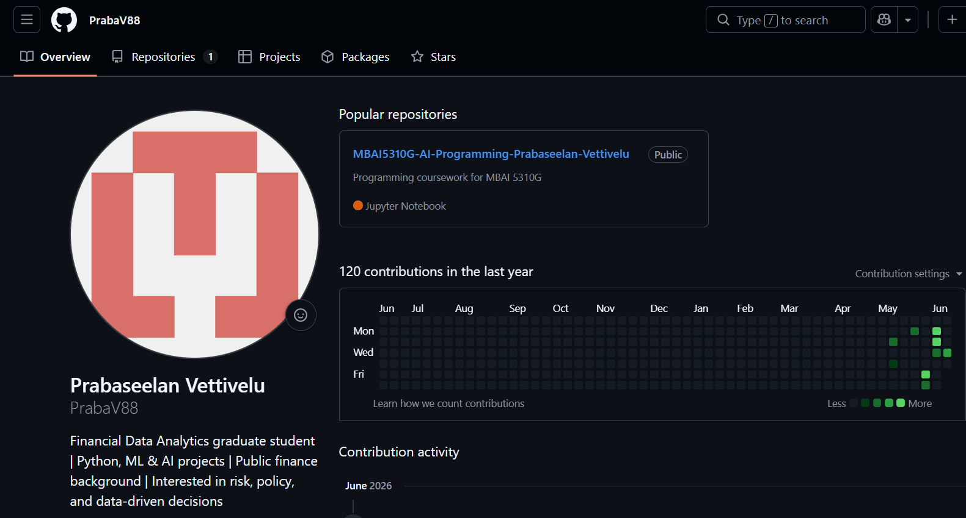
GITHUB PORTFOLIO
1. Repository overview
WHAT THE REPOSITORY DEMONSTRATES
Public course repository for MBAI 5310G – AI Programming
Assignment folders, README documentation, reports and outputs
Shows reproducibility, organization and responsible academic data use
119
5+
1
commits
coursework folders
research folder
Live demo path: Main repo → Research_Proposal → Stage 2 proposal → conceptual framework
MBAI 5310G · AI Programming · Prabaseelan Vettivelu
2
Notes:
This is my public GitHub profile and course repository. I organized the repository so the professor can easily review my coursework evidence, outputs, and the full research proposal development.

Slide 4
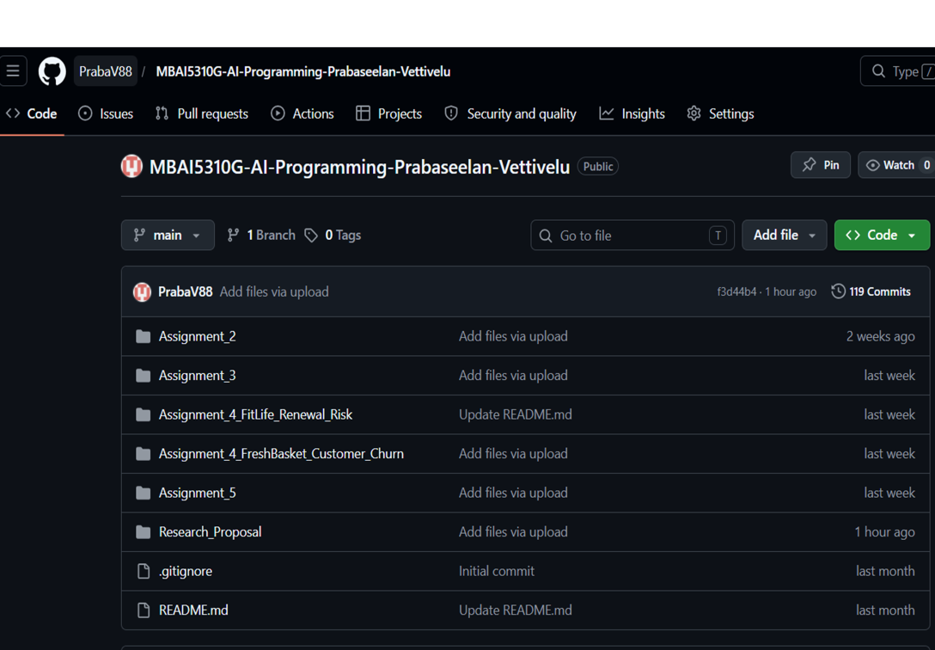
GITHUB PORTFOLIO
2. Repository structure and files
Current organization
Assignment_2 — end-to-end ML pipeline
Assignment_3 — Logistic Regression vs SVM
Assignment_4_FitLife — Decision Tree risk prediction
Assignment_4_FreshBasket — churn prediction
Assignment_5 — K-means clustering
Research_Proposal — Stage 1, Stage 2, framework and slides
Each assignment folder includes:
Notebook · Dataset · README · Report · Outputs
This structure makes the repository easy to navigate and reproduce.
MBAI 5310G · AI Programming · Prabaseelan Vettivelu
3
Notes:
This slide shows the main repository structure. I have assignment folders and a separate Research_Proposal folder. Each assignment folder contains the key files needed to understand and reproduce the work.

Slide 5
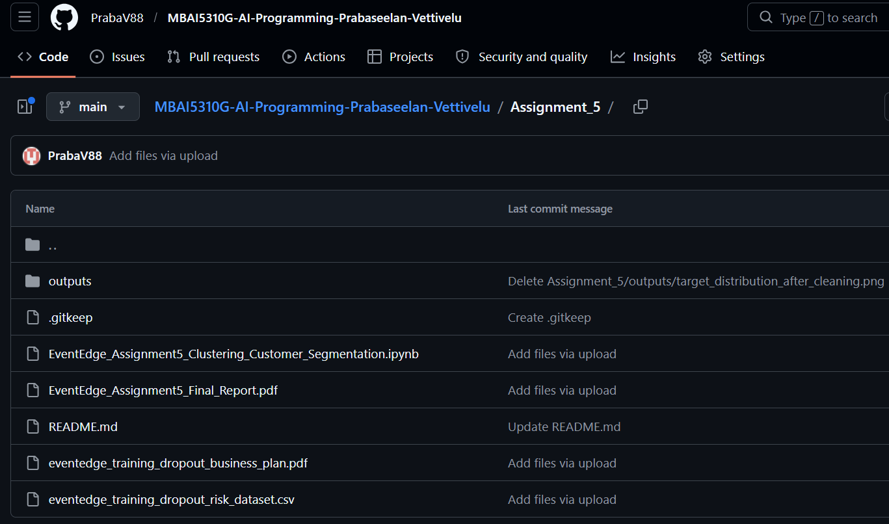
GITHUB PORTFOLIO
3. Example assignment evidence: Assignment 5
WHY I WOULD SHOW ASSIGNMENT 5 LIVE
Latest assignment using unsupervised learning
Notebook, dataset, report, README and outputs are visible
K-means clustering and PCA align with the final proposal methodology
Business interpretation and responsible AI reflection are documented
PRESENTATION LINE
“This folder shows my AI programming workflow from data preparation to clustering outputs and business interpretation.”
GitHub part takeaway: the repo supports documentation, reproducibility and review.
MBAI 5310G · AI Programming · Prabaseelan Vettivelu
4
Notes:
For the live demo I would use Assignment 5 because it is a clear example of my latest AI work. It includes the notebook, dataset, report, README, and outputs folder.

Slide 6
PART B
02
Research Proposal
Topic, gap, methodology, contribution, timeline, and key references
Inflation Targeting and Financial Stability in Selected Emerging and Developed Economies, 1995–2022: A Data Science-Based Study Using Four Stability Indicators
MBAI 5310G · AI Programming · Prabaseelan Vettivelu

Slide 7
RESEARCH PROPOSAL
4. Background and problem statement
Why this topic matters
Main problem
Inflation targeting can improve credibility, transparency and inflation expectations
Price stability does not automatically guarantee financial stability
Financial stability includes banking, credit, exchange-rate and inflation pressures
The relationship between inflation targeting and financial stability remains unclear.
WHY ONE INDICATOR IS NOT ENOUGH
Some studies find banking stability benefits
Others find credit booms, exchange-rate pressure or fragility
The proposal uses four financial-stability indicators to classify risk
Banking stability
Credit growth
Exchange-rate volatility
Inflation volatility
Proposal response: build a country-year risk label and use AI/data science to classify and interpret patterns.
MBAI 5310G · AI Programming · Prabaseelan Vettivelu
5
Notes:
Inflation targeting is designed to stabilize inflation, but financial stability is broader. A country can have stable inflation but still face banking risk, rapid credit growth, or exchange-rate volatility. My study addresses this by using four indicators.

Slide 8
RESEARCH PROPOSAL
5. Research gap
1
Mixed evidence
4
Methodological gap
Prior studies do not agree whether inflation targeting is stabilizing or risky.
Traditional regressions may miss nonlinear and classification-based risk patterns.
2
Measurement gap
5
Data-structure issue
Many studies focus on one channel instead of multiple stability indicators.
Some early developed targeters have limited within-sample IT variation.
3
Country comparison gap
Emerging and developed economies differ in institutions and shock exposure.
This study addresses the gap by combining four indicators with classification, clustering, evaluation and interpretation.
Key message: the proposal is finance-first; AI/data science is used as the analytical method.
MBAI 5310G · AI Programming · Prabaseelan Vettivelu
6
Notes:
The research gap is not only that the literature is mixed. The deeper problem is that financial stability is multidimensional, countries differ, and traditional methods may miss nonlinear or classification-based risk patterns.

Slide 9
RESEARCH PROPOSAL
6. Aim and research questions
AIM
To examine the relationship between inflation-targeting monetary policy and financial-stability risk in selected emerging and developed economies from 1995 to 2022, using a data science-based methodology.
CORE FINANCE QUESTIONS
AI/DATA SCIENCE QUESTIONS
How is inflation targeting related to financial-stability risk?
How does the relationship differ across emerging and developed economies?
Which stability indicators show clearer associations?
Can classification identify high-risk country-years?
Can clustering reveal financial-stability profiles?
Which variables explain the risk patterns?
The AI part is not a new topic — it is the method used to study inflation targeting and financial stability.
MBAI 5310G · AI Programming · Prabaseelan Vettivelu
7
Notes:
The aim is straightforward. The research questions are finance-first, and the AI questions explain how I will analyze the data using classification, clustering, and interpretation.

Slide 10
RESEARCH PROPOSAL
7. Brief literature review
A
Inflation targeting foundation
C
Cautionary evidence
Bernanke & Mishkin; Mishkin & Schmidt-Hebbel — credibility, transparency and inflation performance.
Fouejieu; Frappa & Mésonnier; Akram & Eitrheim — fragility, credit, housing and asset-price risks.
B
Supportive stability evidence
D
Context and policy conditions
Fazio et al.; Mishra & Dubey — banking stability and spillover effects.
Fazio et al.; Kim & Mehrotra; Mugrabi et al.; Woodford — institutions, macroprudential policy and flexible IT.
Literature conclusion
Inflation targeting is neither uniformly stabilizing nor uniformly destabilizing. Its relationship with financial stability depends on indicator, country type, institutional quality and macroprudential policy.
MBAI 5310G · AI Programming · Prabaseelan Vettivelu
8
Notes:
I will not describe each paper separately. I group the literature into foundations, supportive findings, cautionary findings, and context. The important takeaway is that results are mixed, so my proposal needs a balanced approach.

Slide 11
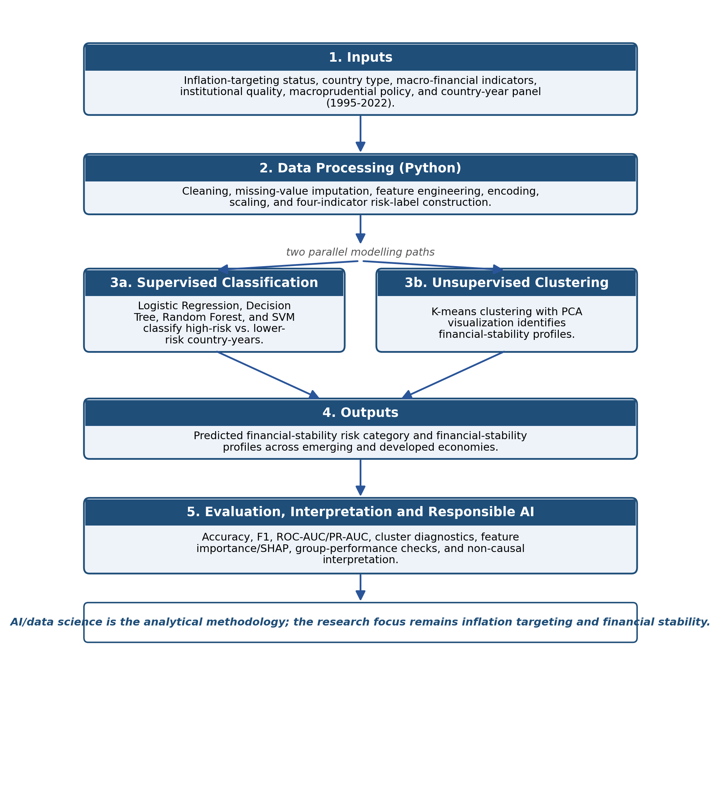
RESEARCH PROPOSAL
8. Conceptual framework
HOW THE STUDY IS FRAMED
Inputs: inflation targeting status, country type, institutional quality and policy indicators
Outcome: financial-stability risk based on four indicators
Two analysis paths: supervised classification and unsupervised clustering
Interpretation remains predictive and associative, not causal
FOUR STABILITY INDICATORS
Banking stability
Credit growth
Exchange-rate volatility
Inflation volatility
AI/data science is used as the analytical methodology; the research focus remains inflation targeting and financial stability.
MBAI 5310G · AI Programming · Prabaseelan Vettivelu
9
Notes:
This figure shows the logic of the study. Data are processed in Python, a risk label is created from four indicators, and the study uses both supervised classification and unsupervised clustering.

Slide 12
RESEARCH PROPOSAL
9. Methodology: how the study can be completed
Data
Risk label
Models
Validation
Explain
Up to 20 economies
1995–2022 country-years
Four indicators
25–30% high-risk cut-off
Logistic Regression
Decision Tree · RF · SVM
Accuracy · F1 · ROC-AUC
PR-AUC · grouped checks
Feature importance
SHAP/LIME if feasible
TWO MODELLING PATHS
RESPONSIBLE INTERPRETATION
Supervised classification: predict high vs lower risk country-years
Unsupervised clustering: identify financial-stability profiles using K-means + PCA
Leakage control: same-year stability indicators used to create the label will not be used as predictors
Secondary country-level data only
Results are exploratory, predictive and associative
Small-sample caution and group performance checks will be reported
Tools: Python · pandas · scikit-learn · Jupyter/Colab · GitHub
MBAI 5310G · AI Programming · Prabaseelan Vettivelu
10
Notes:
The unit of analysis is a country-year. I will collect secondary macro-financial data, create the risk label, train classification models, and use clustering to identify profiles. I will also use leakage control and careful non-causal interpretation.

Slide 13
RESEARCH PROPOSAL
10. Expected contribution, timeline and key references
EXPECTED CONTRIBUTION
KEY REFERENCES
Academic: connects inflation-targeting literature with risk classification
Practical: supports macro-financial risk screening
Methodological: reproducible Python workflow with explainability and responsible AI
Bernanke & Mishkin (1997)
Mishkin & Schmidt-Hebbel (2007)
Fazio et al. (2015, 2018)
Fouejieu (2017)
Frappa & Mésonnier (2010)
Woodford (2012); Hammond (2012)
Mugrabi et al. (2026); Ngepah et al. (2026)
PROPOSED COMPLETION PATH
Stage 1
Completed
Stage 2
Current
Data
Collect & screen
Models
Train & evaluate
Final
Notebook + GitHub
Thank you
MBAI 5310G · AI Programming · Prabaseelan Vettivelu
11
Notes:
I will close by summarizing the contribution. Academically, the study links inflation targeting and financial stability with machine learning risk classification. Practically, it supports macro-financial risk screening. Methodologically, it creates a reproducible Python workflow.

